Slide 1



FINAL PROJECT PRESENTATION
EEG-Based Modeling of Cognitive State and Workload in an Architectural Design
Rachel, Touhid, Yao
DS 5006 Spring 2026

Slide 2
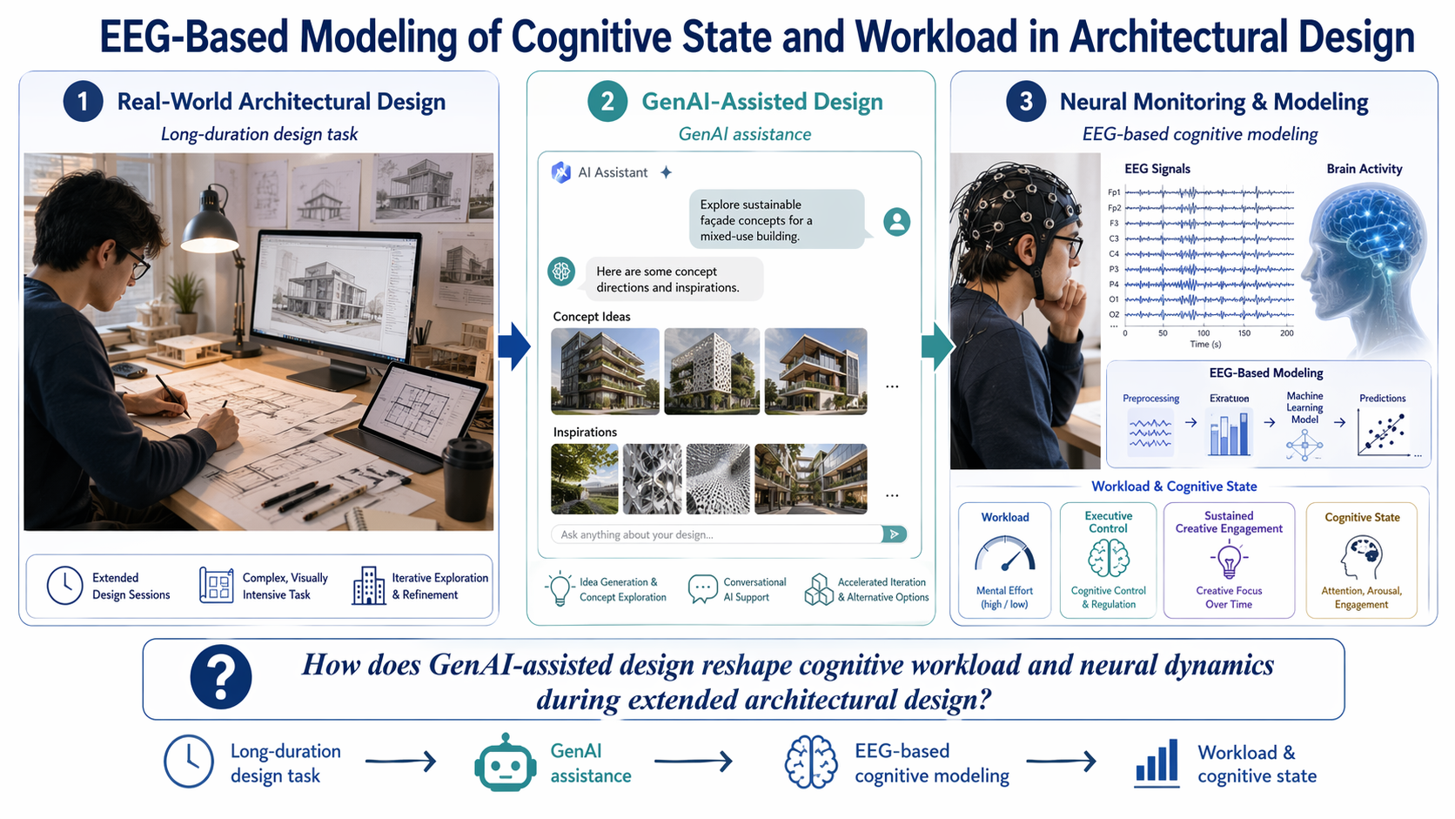
Project Background and Research Goal
Notes:
Today I will introduce my project, EEG-Based Modeling of Cognitive State and Workload in Architectural Design.
This project aims to understand the neural mechanisms underlying long-duration architectural design tasks in realistic settings. In particular, I am interested in how Generative AI assistance may influence brian activity signal features.Unlike traditional laboratory studies that use short and highly controlled trials, this project focuses on continuous, ecologically valid design activity over a much longer time scale.

Slide 3
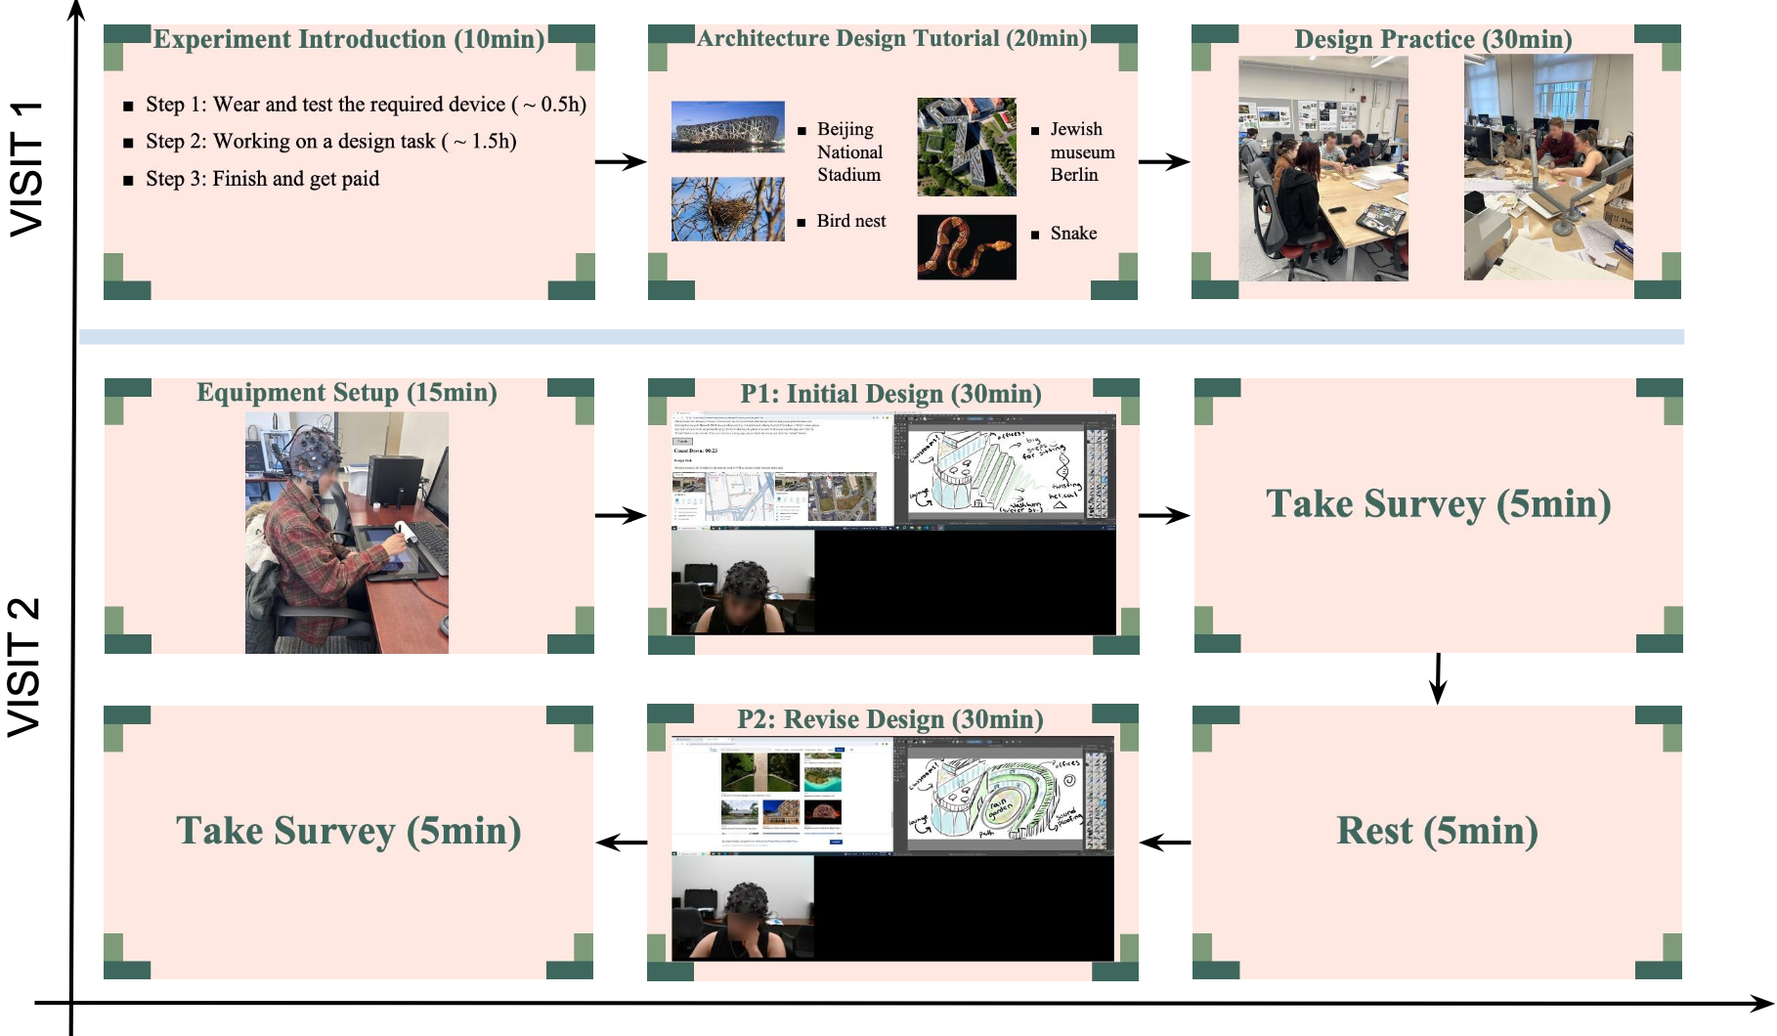
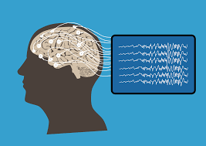
Experimental Procedure and Data
two phases: Task1 (brain-only/30min), Task2 (either conventional search or GenAI-assisted revision/30min)
Participants: 34
EEG recorded with 16 wet electrodes at 500 Hz
Coverage: frontal, central, and parietal regions
Post-task self-report survey used to capture subjective workload
Notes:
In this study, participants completed a real architectural design task organized into four phases: Rest 1, Task 1, Rest 2, and Task 2. Task 1 , and Task 2 was a revision phase in which participants either used conventional inspiration search or a Generative AI-assisted condition. For neural recording, the study used a EEG system. The EEG setup included 16 wet electrodes with frontal, central, and parietal coverage, and 500 Hz sample rate
To measure subjective workload, participants completed a NASA-TLX-style workload questionnaire, which evaluates multiple dimensions of workload.

Slide 4
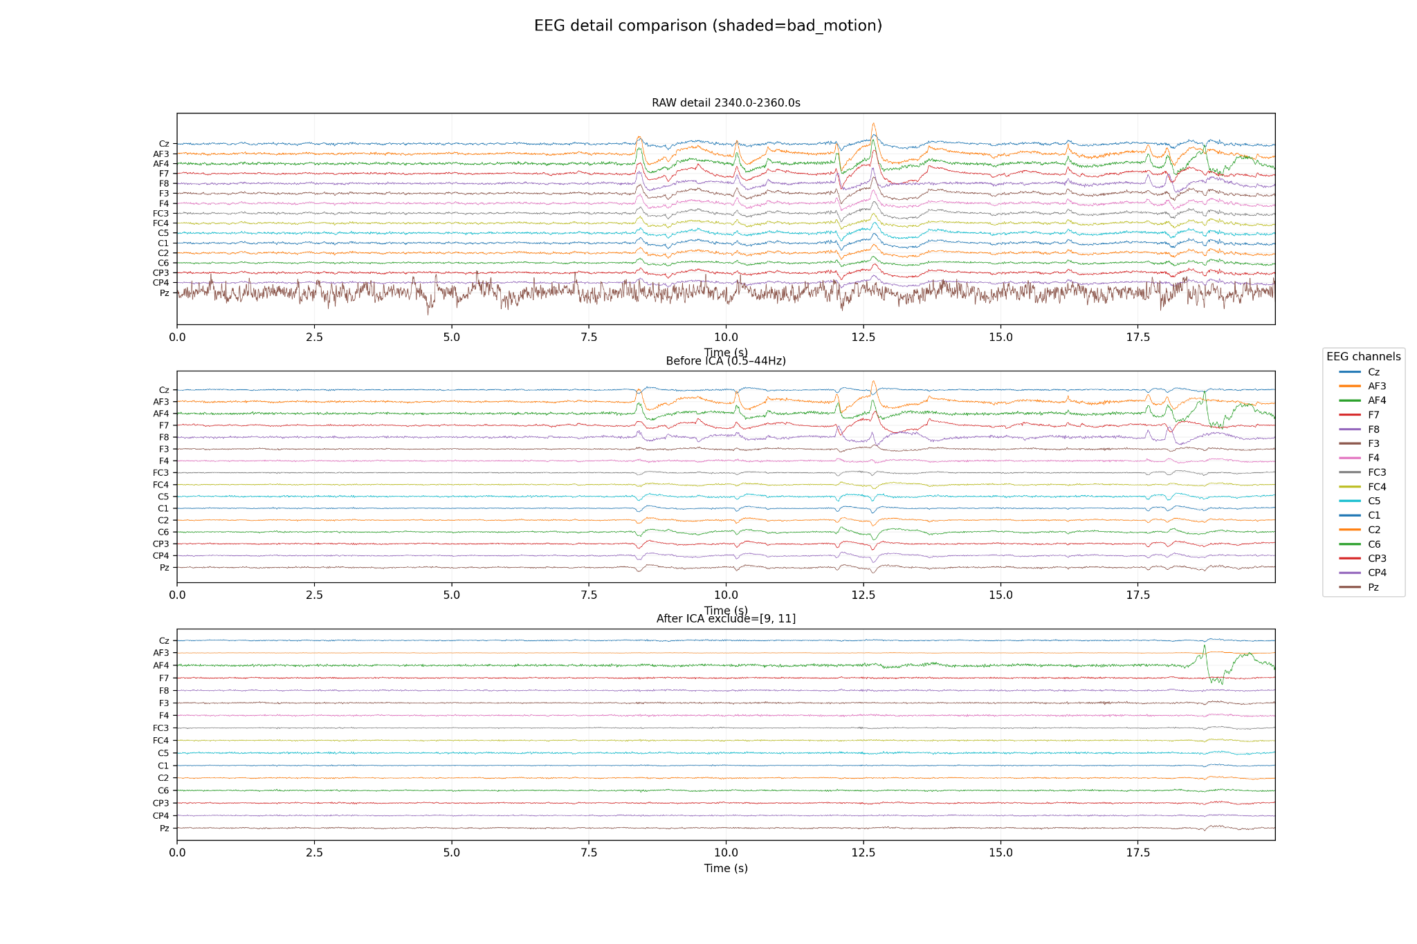
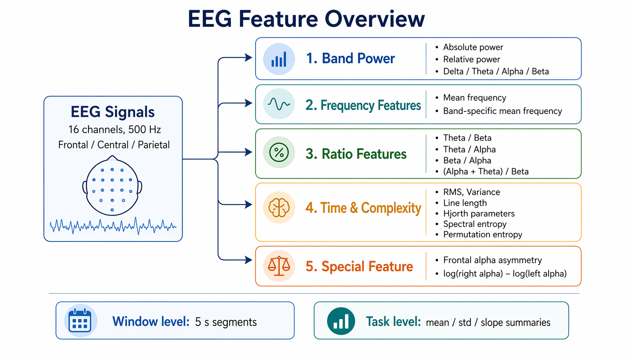
EEG Preprocessing and Feature Extraction
Remove first 2 s, notch filter at 60 Hz
RANSAC bad-channel detection, average reference
Bandpass filter: 0.5–44 Hz
ICA + ICLabel for artifact removal
Extract PSD, RMS, variance, and time–frequency features (261 features)
Notes:
The preprocessing pipeline is designed to remove noise and artifacts while preserving meaningful neural signals. After preprocessing, we extracted EEG features by referring other published papers, Window-level features are first computed and then aggregated across the task. For each base
feature, we have mean, std, and slope over time.finally we including 261 features.

Slide 5
Modeling Tasks: Classification and Regression
Task 1: Classification
Predict the experimental condition from EEG features
Main goal: test whether neural features can differentiate different design conditions.
This helps evaluate whether design modes produce distinct cognitive states at the neural level.
Task 2: Regression
Predict average workload scores from EEG features
Main goal: examine whether EEG can provide an objective estimate of average workload during architectural design.
Notes:
The analysis focuses on two supervised learning problems. The first is a classification task, where EEG features are used to distinguish between different task conditions. The second is a regression task, where EEG features are used to predict self-reported workload scores.

Slide 6
Task 1: Classification
This was VERY frustrating data

Slide 7
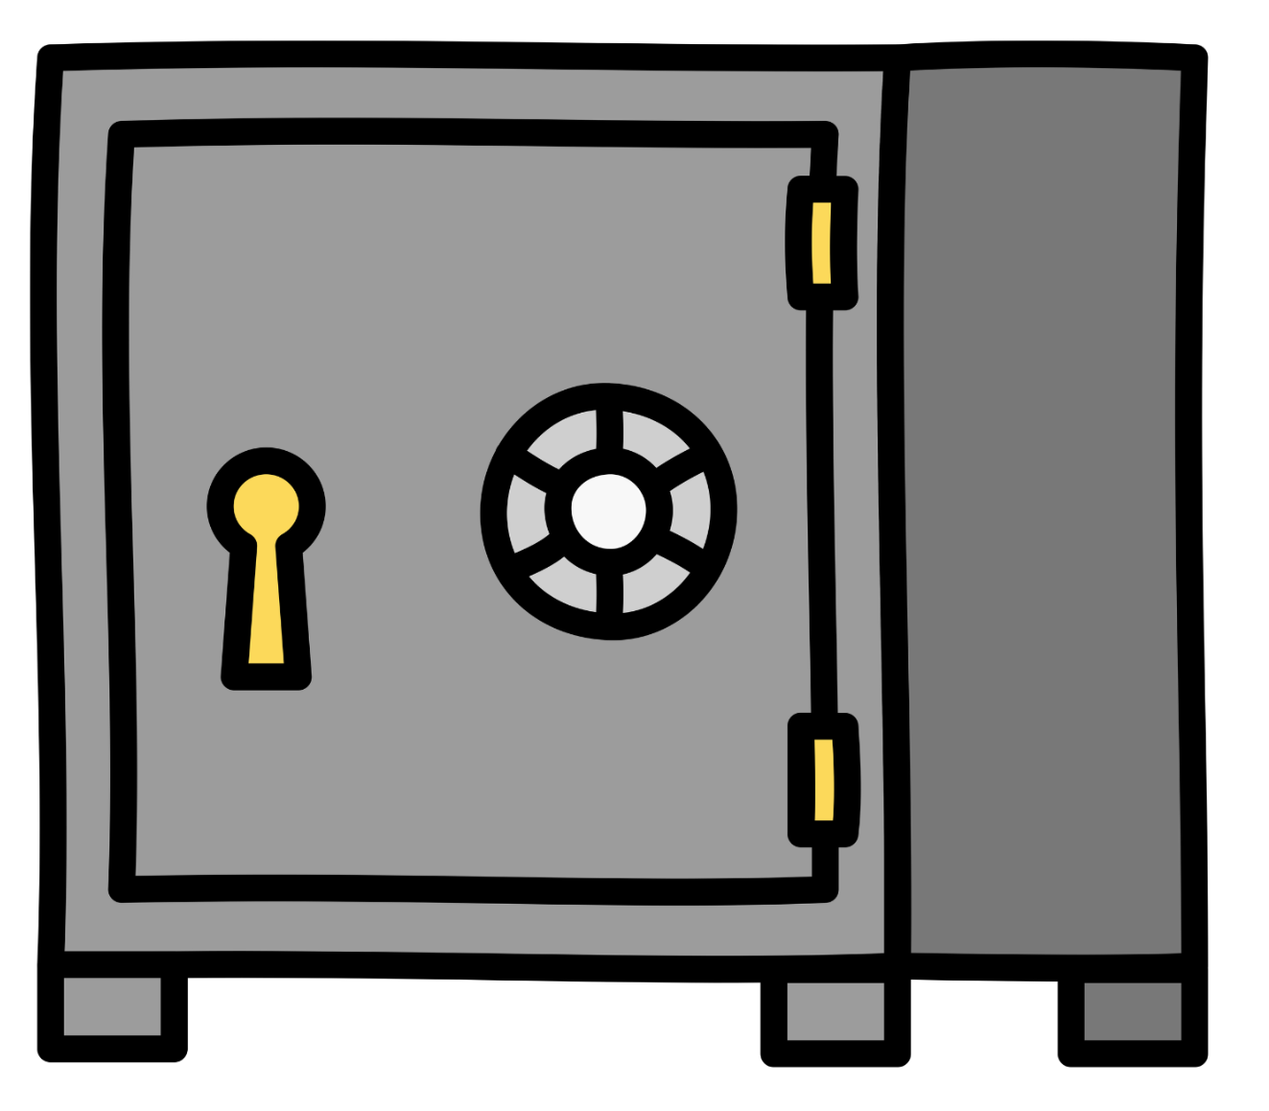
The safe
P3, P27, P40, P72 (both task 1 and 2)
100%
89% for training and testing

Slide 8
Data Leakage
GroupKfold cross validation
(Also scale for ridge and lasso)
P1
P1
P1
P1

Slide 9
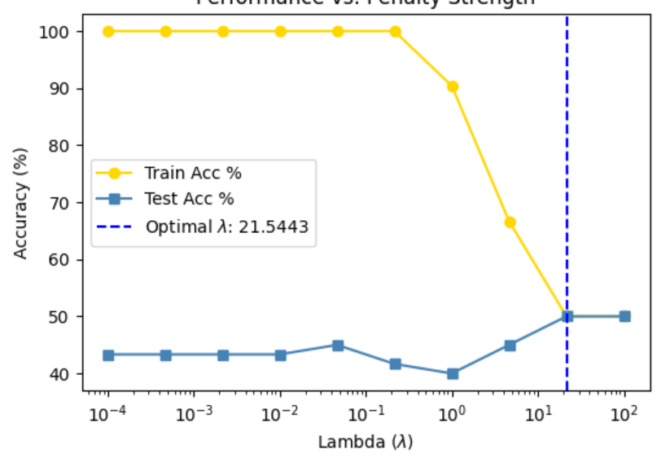
Model 1: Logistic Regression with Lasso
Categorical Problem: Can we distinguish between brain only, chatgpt, and search?
Lasso to penalize some terms to zero (have 172)
Training accuracy= 50%, testing accuracy= 50% (slightly better than random, 33% but still just guessing)
Strong penalty: lambda=21.5

Slide 10
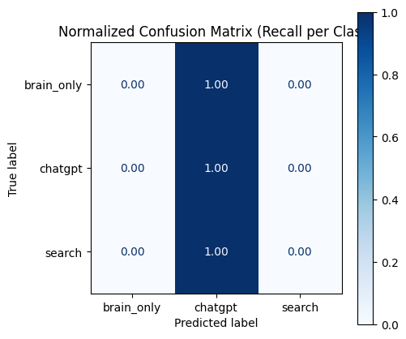
Model 1: Logistic Regression with Lasso is Guessing

Slide 11
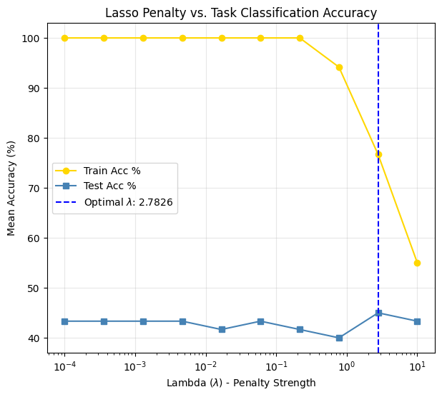
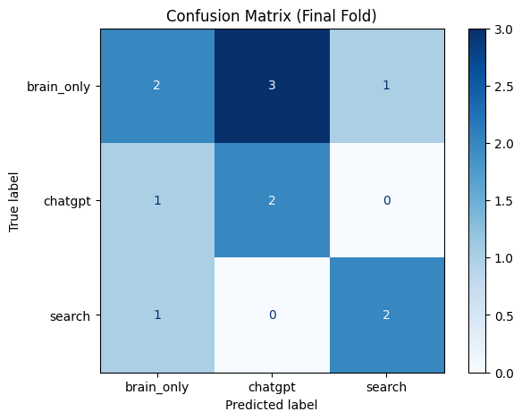
Model 2: Logistic Regression with Limit on Pentalty
No longer randomly guessing
Keeps 24 features, 76.7% training accuracy, 45% testing accuracy

Slide 12
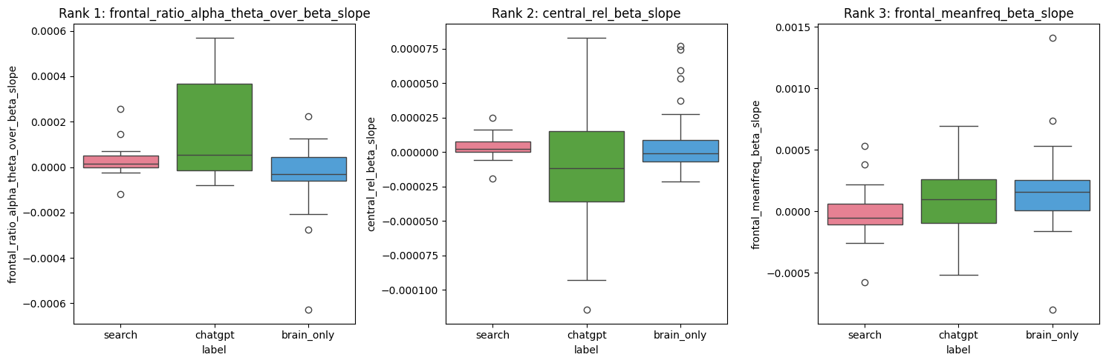
Model 2: Interesting Information
(ɑ+Θ)/β high for chatgpt
Central rel β slope high for brain only outliers
Central mean freq β slope low for search

Slide 13
Use domain knowledge
Higher theta/beta band ratio (TBR) is closely associated with lower attentional function [1]
Higher (alpha+theta)/beta more sleepy/relaxed [2]
Frontal alpha asymmetry (log(alpha power at Right front) – log(alpha power at Left front)) - Higher is approach behaviors (anger, optimism), negative is withdrawals behaviors (depression, anxiety) [3]
Including mean frequency, absolute power, and relative power for classification of resting and working memory states [4]
Can be region specific as well (front, central, back)
(Now 68 features)

Slide 14
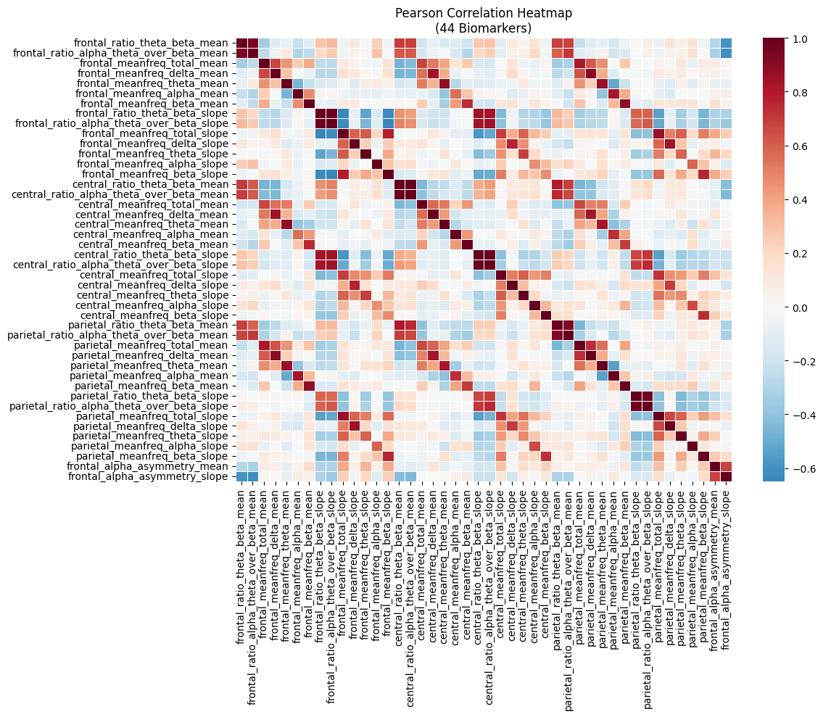
Removing redundant information
Reduced to 38 features

Slide 15
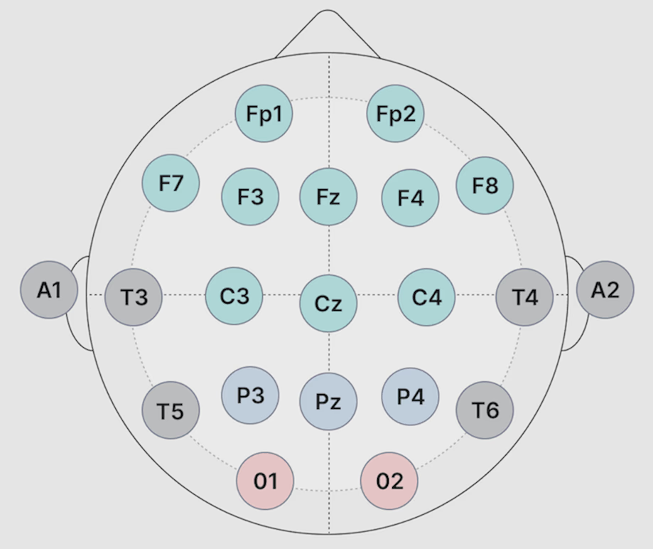
Random Forest is Best but there is Data Leakage
Training accuracy: 100% Testing 53.3%
Top three features
Parietal_ratio_theta_beta_slope
Central_meanfreq_total_slope
frontal_ratio_theta_beta_slope

Slide 16
What do we need: Simple trees in a simple forest
Likely memorizing participants
Lower max depth to 2, ensure uses minimum of five samples per leaf
Training error 89.2%, testing 53.3%

Slide 17
Next steps feature engineering and selection
Can we feature engineer for better performance (PCA)?
Region specific?
Chat gpt vs others?

Slide 18
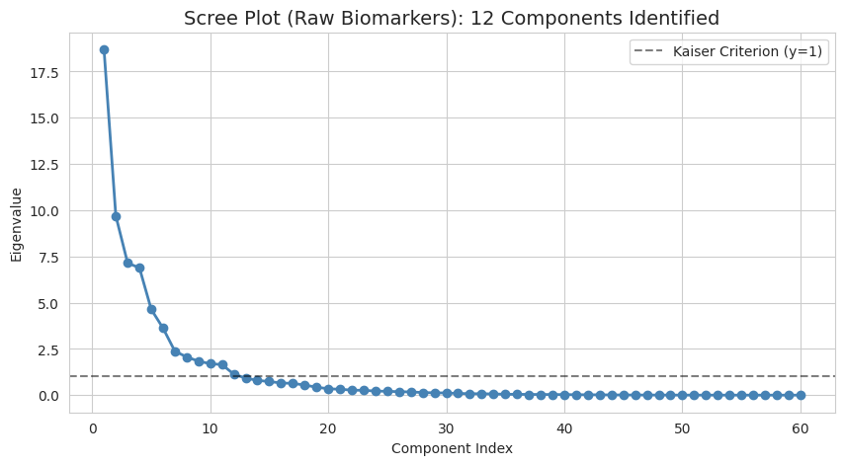
Lets start with PCA

Slide 19
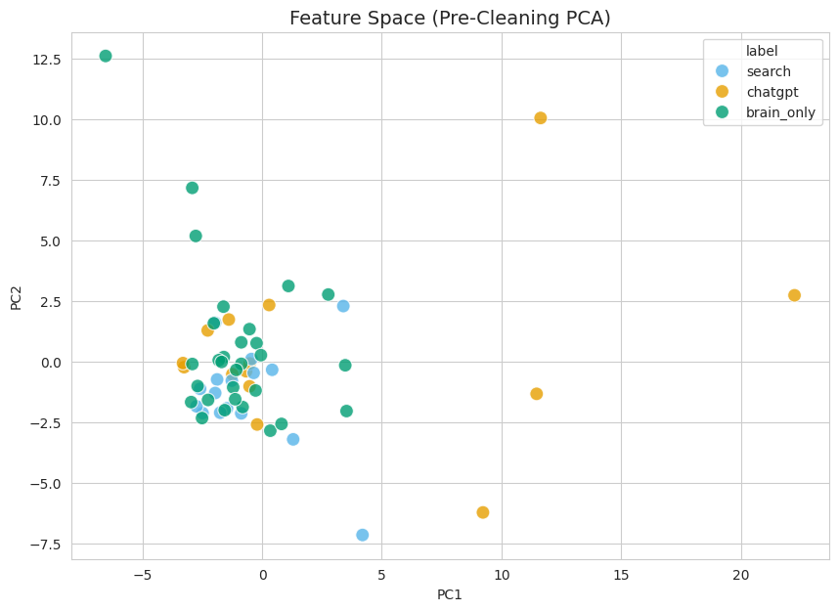
PCA Plots
Training: 85.4%
Testing: 46.7%
For PC1, larger values
for Chatgpt
PC1 has lots
Of central data
PC2 has lots
Of frontal data

Slide 20
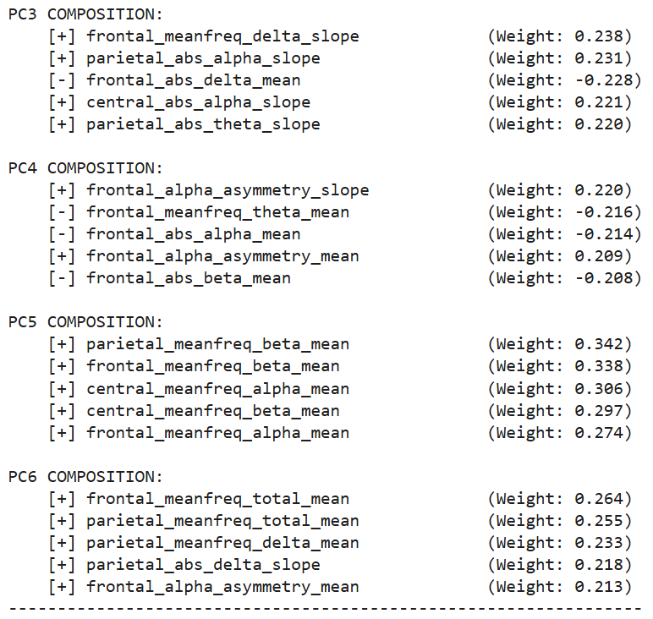
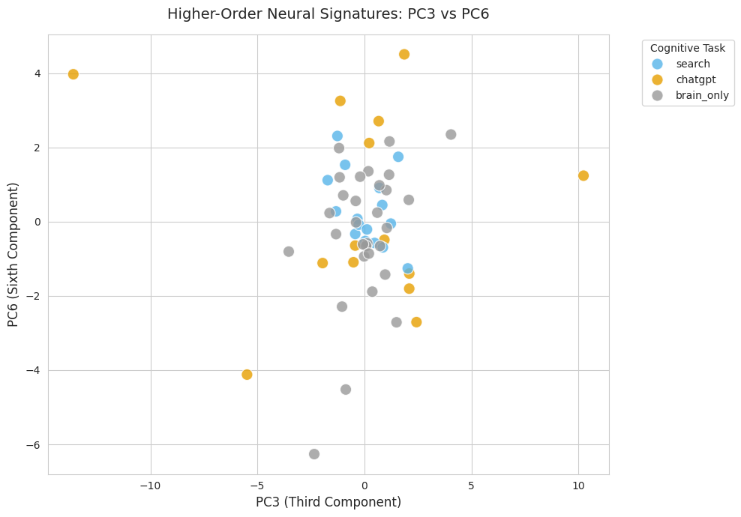
Decision tree for illustration
PC6
PC3<2.09
PC6<2.05
Chatgpt (8.3%)
Search (80%)
Chatgpt (11.7%)
Can distinguish Chatgpt okay
But impossible search vs brain only
PC3

Slide 21
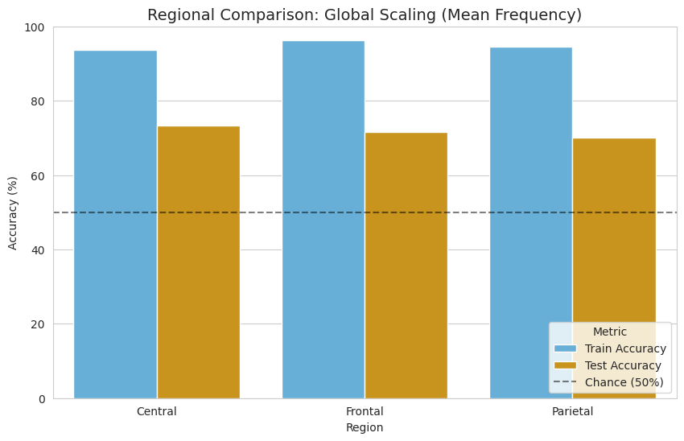
Can we predict chatgpt with just meanfreq and 1 region?
93.8% 96.3% 94.6%
73.3% 71.7% 70.0%

Slide 22
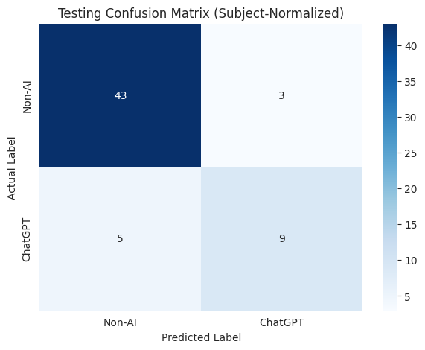
Frontal region, 2 predictors
Use class weights = balanced
Scale per participant
Testing accuracy 86.7%
Features used
Frontal theta/beta slope
Frontal (alpha+theta)/beta slope
ChatGPT group more sleepy,
less attention

Slide 23
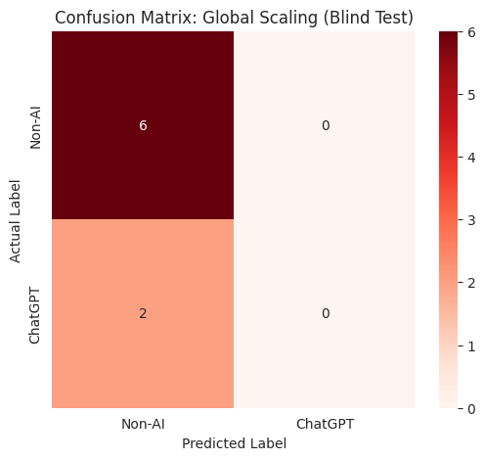
Because without subject specific scaling

Slide 24
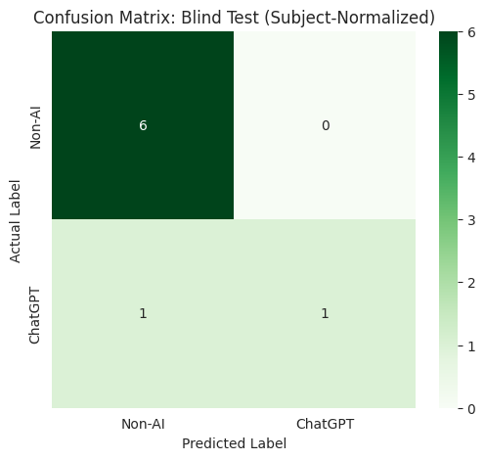
Checking the safe (heirarchical cross validation)
Use class weights = balanced
Scale per participant
Accuracy 87.5%

Slide 25
Conclusions
Chatgpt distinct from brain only and search
Can be identified with few predictors
Need to express caution with unbalanced data, avoid random guessing
Subject specific scaling targets how people change with condition from brain only
Chatgpt uses tend to have higher theta/beta band ratio (TBR) (attention function slope) and (alpha+theta)/beta (more sleepy slope)

Slide 26
Can we Achieve the same results with only 5-min of data
Answer: No, slope changes over entire 30-min, not in just 5.
Means different for ChatGPT group, non AI and ChatGPT more similar first 5 mins
Feature | Analysis Window | Mean (ChatGPT) | Mean (Non-AI) | % Difference | Cohen's d | p-Value
Frontal Theta/Beta | Full Session | 0.339 | 0.255 | +33.1% | 0.591 (Med) | 0.156
 | 5-Min Snapshot | 0.264 | 0.271 | -2.6% | -0.052 | 0.867
Alpha-Theta / Beta | Full Session | 0.559 | 0.444 | +25.8% | 0.522 (Med) | 0.202
 | 5-Min Snapshot | 0.446 | 0.452 | -1.2% | -0.027 | 0.937

Slide 27
Can we Achieve the same results with only 5-min of data
Answer: No, slope changes over entire 30-min, not in just 5.
Means different for ChatGPT group, non AI and ChatGPT more similar first 5 mins
Feature | Analysis Window | Mean (ChatGPT) | Mean (Non-AI) | % Difference | Cohen's d | p-Value
Frontal Theta/Beta | Full Session | 0.339 | 0.255 | +33.1% | 0.591 (Med) | 0.156
 | 5-Min Snapshot | 0.264 | 0.271 | -2.6% | -0.052 | 0.867
Alpha-Theta / Beta | Full Session | 0.559 | 0.444 | +25.8% | 0.522 (Med) | 0.202
 | 5-Min Snapshot | 0.446 | 0.452 | -1.2% | -0.027 | 0.937

Slide 28
Task 2: Regression

Slide 29
Objectives
Predict average workload using EEG-derived features
Two task settings:
Task 1: Brain Only
Task 2: Search / ChatGPT

Slide 30
Dataset
Total dataset: 68 rows × 278 columns (High-dimensional, small-sample data)
Split into two subsets:
Task 1: 34 samples
Task 2: 34 samples
Predictors: 258 EEG features
Target: Average workload

Slide 31
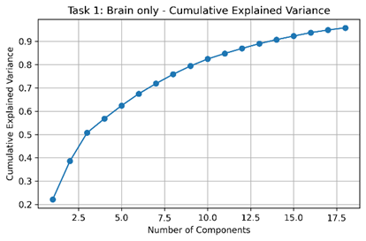
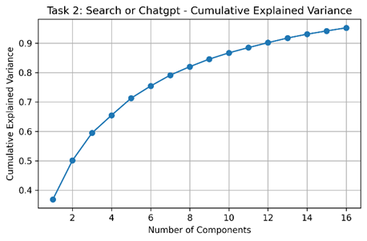
PCA
Applied Principal Component Analysis (PCA)
Purpose:
Reduce dimensionality
Handle correlated EEG features
Results:
Task 2 → 16 components
Task 1 → 18 components
95% variance retained

Slide 32
Models
Ridge
Lasso
Elastic Net
Support Vector Regression (SVR)
Random Forest

Slide 33
K-Fold Cross-Validation(k=5)
Used K-Fold Cross-Validation
Why?
Small dataset → unstable single split
Benefits:
More robust performance estimate

Slide 34
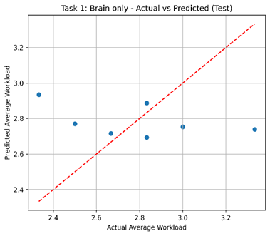
Results Task 1: Brain only

Slide 35
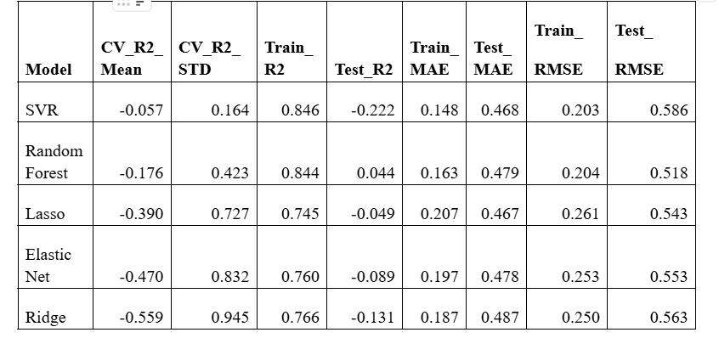
Results Task 2: Search/Chat-GPT

Slide 36
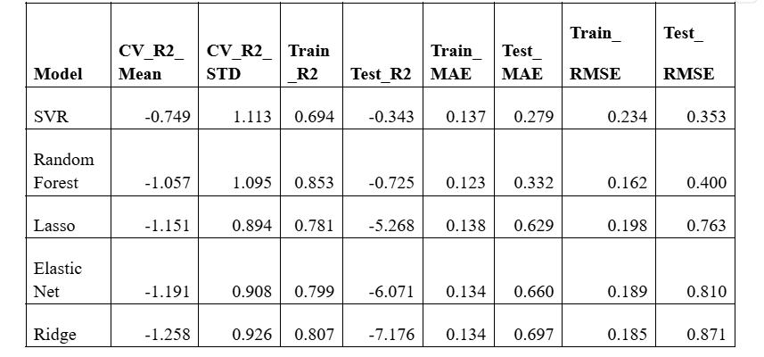

Slide 37
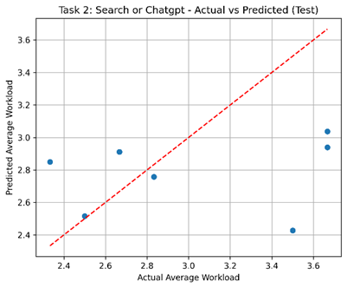
Results Task 2: Search/Chat-GPT

Slide 38
Conclusion
Workload regression was a small-sample, high-dimensional problem, so PCA-based dimensionality reduction was necessary.
SVR was the best-performing regression model, suggesting the relationship between EEG and workload may be nonlinear.
Even the best regression results were still not strong enough for reliable workload prediction, with weak generalization and low or negative R².

Slide 39
Links
[1] https://doi.org/10.1016/j.sleep.2025.108723
[2] https://www.sciencedirect.com/science/article/pii/S0360132325011436
[3] https://doi.org/10.1016/j.ijpsycho.2016.11.005
[4] https://www.sciencedirect.com/science/article/pii/S195903182100138X

Slide 40
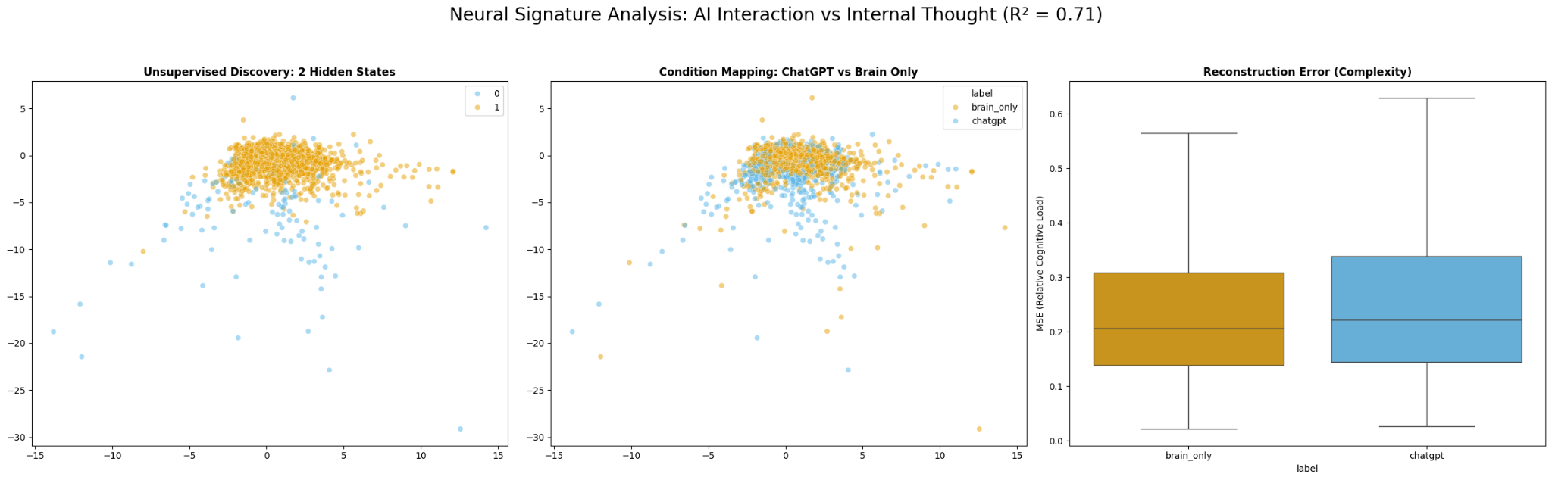
Appendix

Slide 41
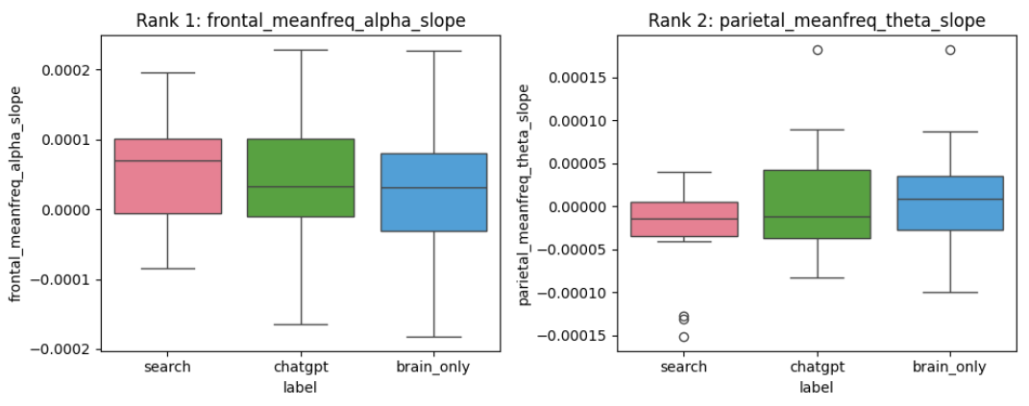
Model 2: Logistic Regression with Ridge
Categorical Problem: Can we distinguish between brain only, chatgpt, and search?
Ridge won’t make coefficients to zero but shrink them
Aim to reduce multicollinearity
Keeps all features
Training Accuracy: 100.00%
Testing Accuracy: 46.67%

Slide 42
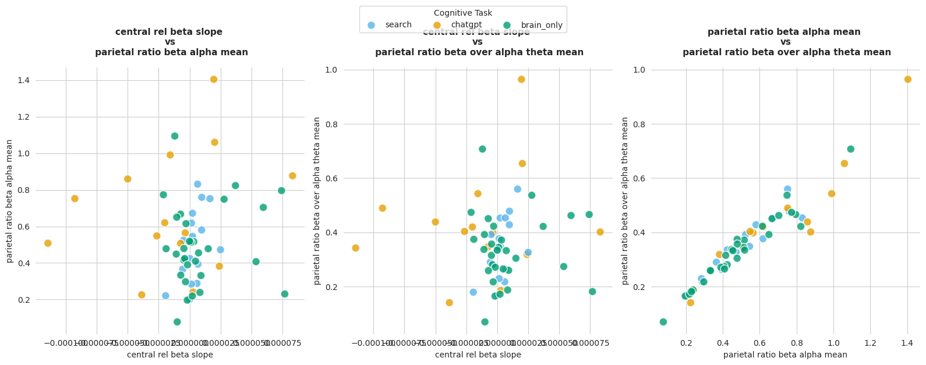
Model 2: Specific lambda (1000), worse performance, more useful
Training Accuracy: 64.2%; Testing Accuracy: 45.0%

Slide 43
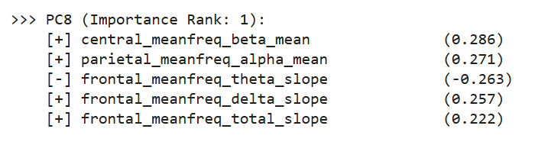
Can we predict chatgpt vs not more accurately?
PCA forest: training accuracy, training 97.8%; testing accuracy 70%
PCA forest with within subject normalization: Training 98.3%; testing 75%

Slide 44
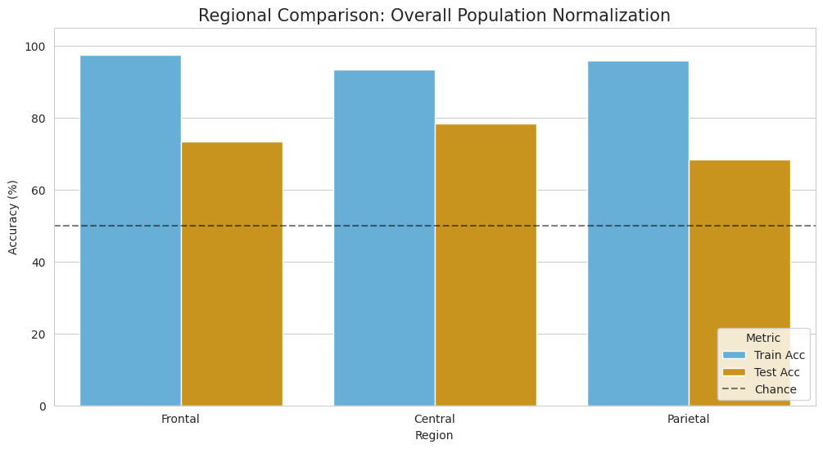
What about just one region all data?
97.5% 93.3% 95.8%
73.3% 78.3% 68.3%

